Slide 1


Lecture 11
Produced by Dr. Worldwide
Welcome to the 305
~
~

Slide 2

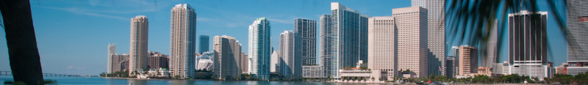
Ex: Give-back Weekend
The Student Government Association (SGA) organizes a recurring event called “Give-Back Weekends” where teams are formed to work on projects for residents in the university community
This event occurs over four consecutive Saturdays in April
Coed teams are formed with 3 to 5 students from various dormitory groups, fraternities, sororities, clubs, and organizations
Residents of the community fill out a form to describe work at their home that needs to be done
Time to complete a project will vary between teams because of the different number of team members, skills of the team, and physical make-up of the team

Slide 3
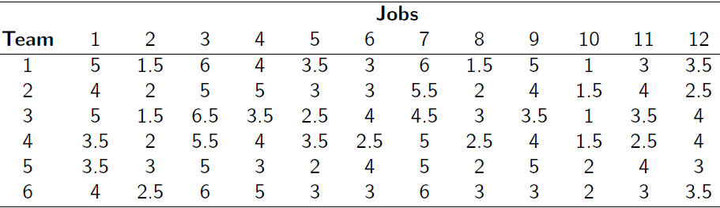
Ex: Give-back Weekend
Time estimates (in hours) submitted by the six teams available to work on 12 different projects for the first Saturday of the event
The primary objective of SGA is to complete all 12 projects

Slide 4
Ex: Give-back Weekend
Teams can work on multiple projects
Teams cannot work more than 8 hours on Saturday
Each team should work on at least one project
Alternative Questions
Q1: How can we assign the 6 teams to the 12 projects to maximize the number of jobs completed on Saturday?
Q2: How can we assign the 6 teams to the 12 projects and minimize the total time required for all 6 teams to complete all projects?

Slide 5
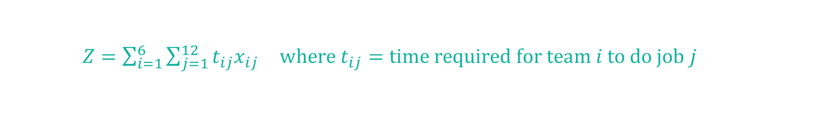
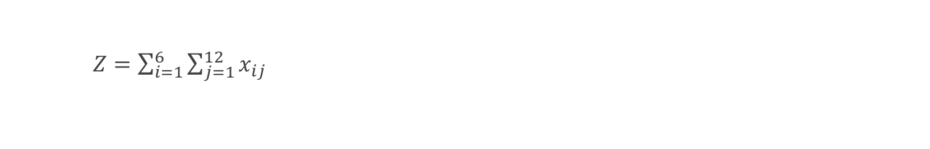
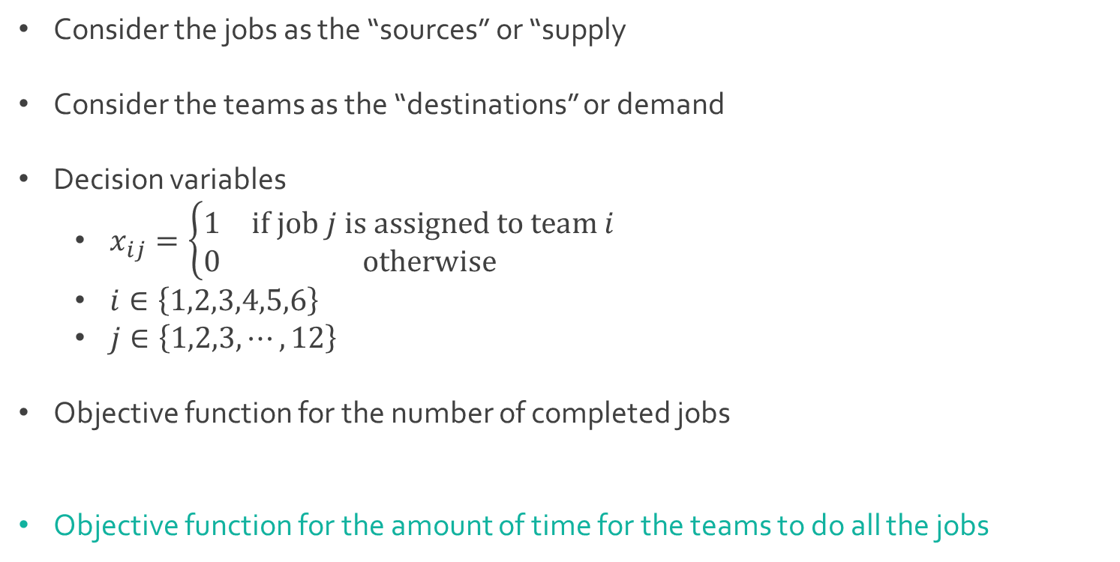
Ex: Give-back Weekend
Consider the jobs as the “sources” or “supply
Consider the teams as the “destinations” or demand
Decision variables
$x_{ij}=\left\{\begin{aligned}\begin{matrix}1 & if job j is assigned to team i \\ 0 & otherwise \end{matrix}\end{aligned}\right.$
$i∈\left\{1,2,3,4,5,6\right\}$
$j∈\left\{1,2,3,⋯,12\right\}$
Objective function for the number of completed jobs
Objective function for the amount of time for the teams to do all the jobs
$Z=\sum_{i=1}^{6}{\sum_{j=1}^{12}{x_{ij}}}$
$Z=\sum_{i=1}^{6}{\sum_{j=1}^{12}{{t_{ij}x}_{ij}}} where t_{ij}=time required for team i to do job j$

Slide 6
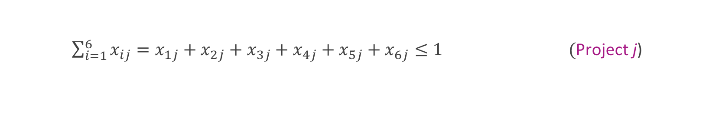
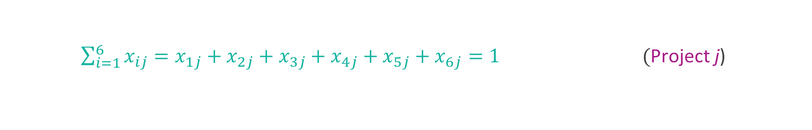

Ex: Give-back Weekend
Constraints
Each team cannot work more than 8 hours
Each project can only be assigned to at most one team, which adds a total of 12 constraints, one for each project $j∈\{1,2,⋯,12\}$
Each project is assigned to exactly one team
Each decision variable is binary
5$x_{11}+1.5x_{12}+6x_{13}+{4x}_{14}+3.5x_{15}+3x_{16}+$
$+6x_{17}+1.5x_{18}+5x_{19}+x_{110}+3x_{111}+3.5x_{112}≤8$(Team 1)
$\sum_{i=1}^{6}{x_{ij}=x_{1j}+x_{2j}+x_{3j}+x_{4j}+x_{5j}+x_{6j}≤1} \text{(}\text{Project} \text{j}\text{)}$
$\sum_{i=1}^{6}{x_{ij}=x_{1j}+x_{2j}+x_{3j}+x_{4j}+x_{5j}+x_{6j}=1} \text{(}\text{Project} \text{j}\text{)}$
$x_{ij}∈\left\{0,1\right\}$

Slide 7
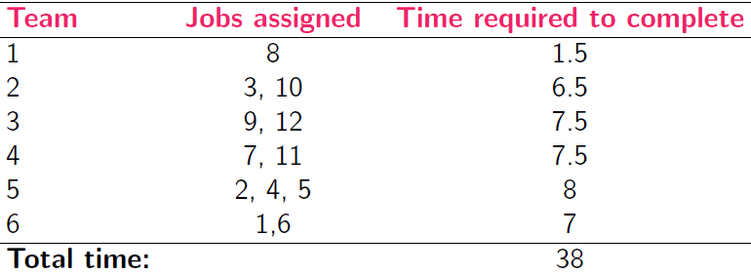
Ex: Give-back Weekend
Download GiveBack.xlsx from course website from link Sheet 1
Solution for Q1 on sheet called Max projects
Maximize the number of projects that can be completed
In general, there can be multiple optimal solutions in assignment problems
Could have assigned job 4 to Team 1 instead of Team 5
Important is the fact that an optimal solution exists to do all 12 jobs

Slide 8
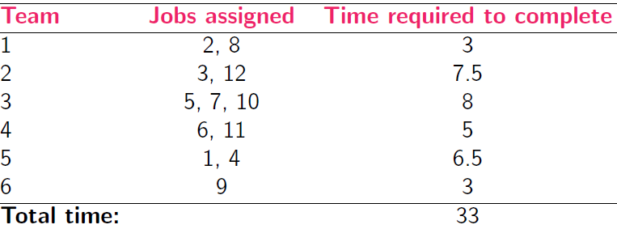
Ex: Give-back Weekend
Solution for Q2 on sheet called Min time
We are trying to identify if a faster way exists where all jobs will still be completed
Minimize the total time required
Q: Do you notice any differences in the optimal solution?
Q: Which solution is better?

Slide 9
Network Flow Models
A network is an arrangement of paths connected at various points
A network has two main components
Nodes represent junction points
Branches or edges represent routes between nodes
Diagrams can be utilized to visualize networks
Nodes represented by circles
Branches represented by lines
Typical goals of transportation problems
Minimize transportation costs
Minimize total distance travelled
Maximize amount transported

Slide 10
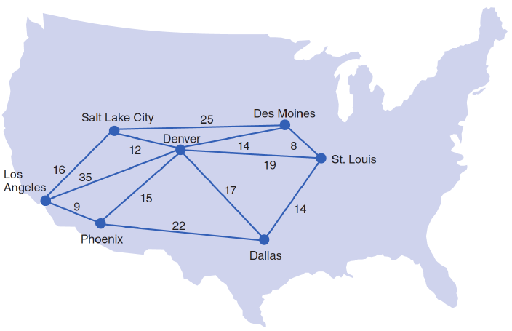
Ex: Shortest Shipping Route
The shortest route problem is to determine the shortest distance between an originating point and several destination points
Stagecoach Shipping Company transports oranges from Los Angeles
Uses 6 trucks to travel to 6 different cities in the West and Midwest
Diagram of network with length of time (hours) between cities for transport

Slide 11
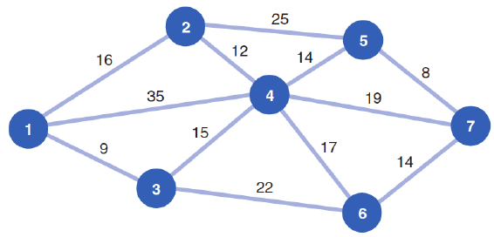
Ex: Shortest Shipping Route
In this problem, we are looking for the shortest route based on time
Simplified network
Q: What is the shortest route from node 1 to each of the other nodes?

Slide 12
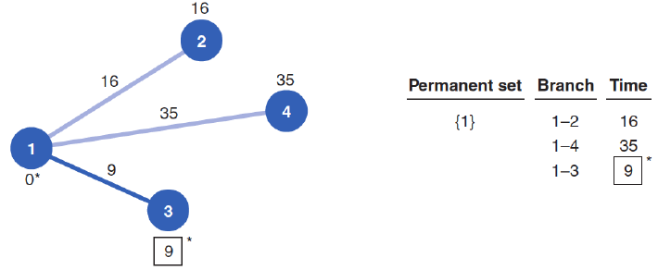
Ex: Shortest Shipping Route
We will keep track of the paths we choose by defining, and then updating a subset of the nodes called the permanent set
To start, define the permanent set to be the origin, node 1
The shortest path from node 1 to any of its adjacent nodes
Node 3 is the closest to node 1
Add node 3 to the permanent set

Slide 13
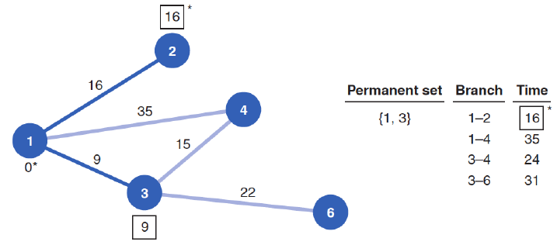
Ex: Shortest Shipping Route
Next, explore all the nodes adjacent to nodes in the permanent set {1,3}
Node 2 is the closest to the origin, so it is added to the permanent set

Slide 14
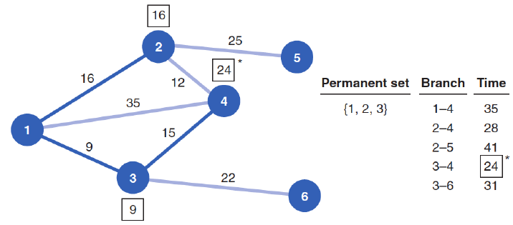
Ex: Shortest Shipping Route
Next, explore all the nodes adjacent to nodes in the permanent set {1,2,3}
Node 4 is the closest to the origin among {4,5,6} and added to the permanent set

Slide 15
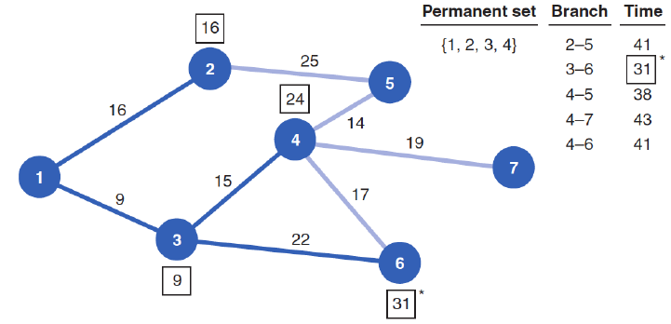
Ex: Shortest Shipping Route
Next, explore all the nodes adjacent to nodes in the permanent set {1,2,3,4}
Node 6 is the closest to the origin and added to the permanent set

Slide 16
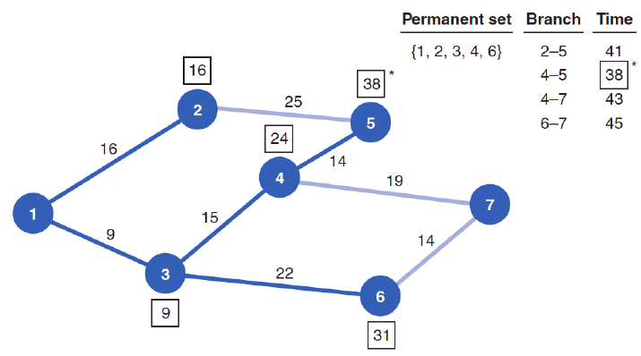
Ex: Shortest Shipping Route
Next, explore all the nodes adjacent to nodes in the permanent set {1,2,3,4,6}
Node 5 is the closest to the origin and added to the permanent set

Slide 17
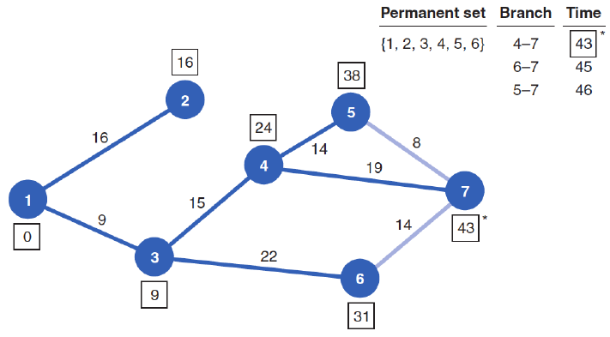
Ex: Shortest Shipping Route
Last, explore all the nodes adjacent to nodes in the permanent set {1,2,3,4,6,5}
Node 7 is the last one added
Minimum time from origin to node 7 is 43 (19+15+9)

Slide 18
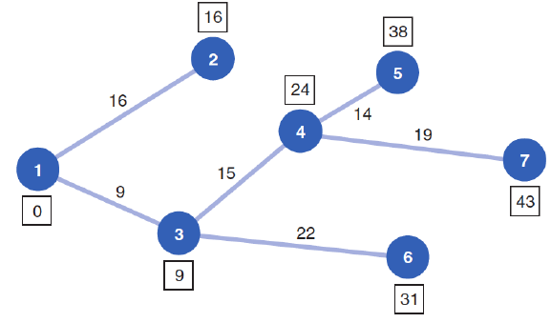

Ex: Shortest Shipping Route
Final solution represented graphically using a subset of the edges
Minimum time travelled from node 1 to all other nodes
$9+16+24+31+38+43=$161

Slide 19
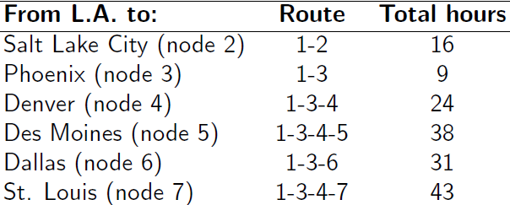
Ex: Shortest Shipping Route
Optimal routes to reach each of the 7 cities
Routes can be expressed using
an ordered list of nodes

Slide 20
Shortest Route Problem
Dijkstra’s algorithm for identifying the shortest route
Step 1: Select the node with the shortest route from the origin
Step 2: Create a permanent set that includes the origin and the node chosen in the 1st step
Step 3: Identify all nodes that are adjacent to the nodes in the permanent set
Step 4: Select the node with the shortest route from the group of nodes adjacent to the nodes in the permanent set. Add the chosen node to the permanent set
Step 5: Repeat the 3rd and 4th steps until all nodes are in the permanent set

Slide 21

Shortest Route Problem
We want to reformulate the problem as a linear program
The origin in the shortest route problem can be thought of as a single supply node
The other nodes can be thought of as demand nodes
Source has supply equal to the number of nodes in the graph minus one (itself)
Each demand node requires a single unit
Distance between nodes corresponds to transportation cost of that edge
To reduce the number of variables, we assume units only flow in the direction of a higher node number
Ignore $x_{ij} if i≥j$

Slide 22
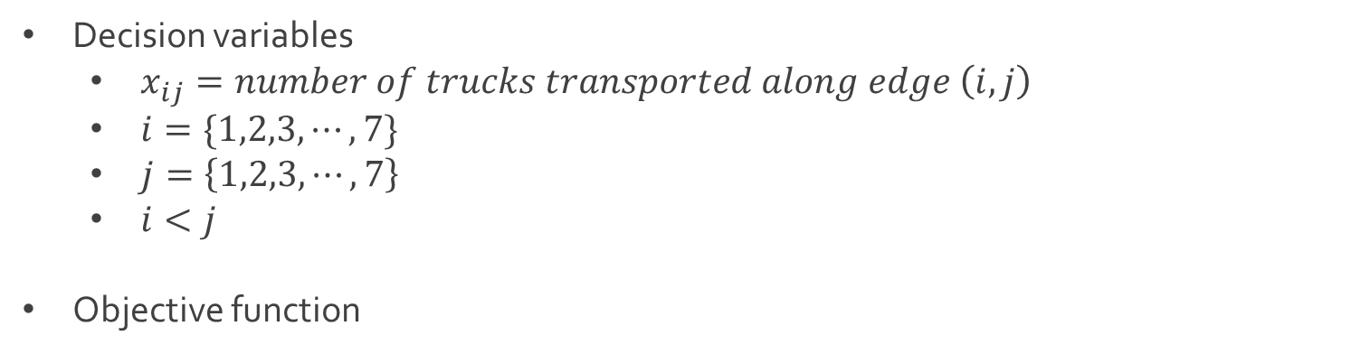
Ex: Shortest Shipping Route
Decision variables
$x_{ij}=number of trucks transported along edge \left(i,j\right)$
$i=\{1,2,3,⋯, 7\}$
$j=\left\{1,2,3,⋯,7\right\}$
$i<j$
Objective function
$$Z=16x_{12}+35x_{14}+9x_{13}+12x_{24}$$
$+15x_{34}+25x_{25}+14x_{45}+17x_{46}$
$+22x_{36}+8x_{57}+19x_{47}+14x_{67}$

Slide 23
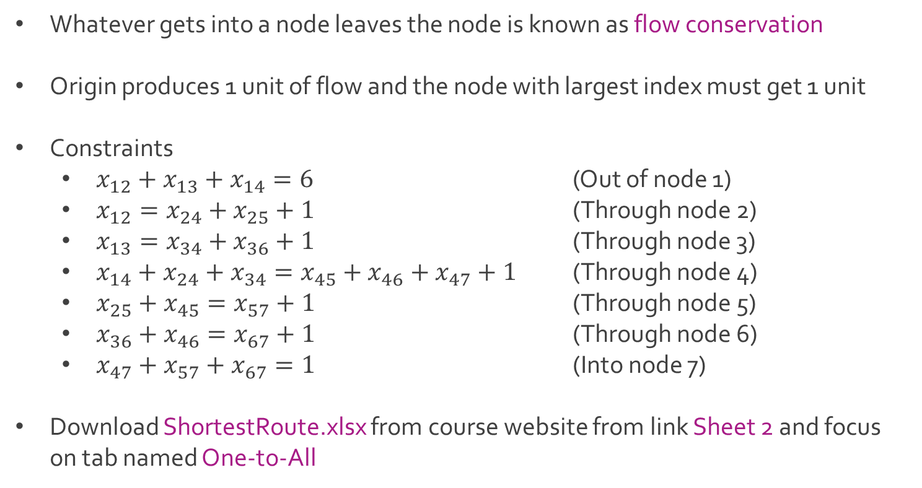
Ex: Shortest Shipping Route
Whatever gets into a node leaves the node is known as flow conservation
Origin produces 1 unit of flow and the node with largest index must get 1 unit
Constraints
$x_{12}+x_{13}+x_{14}=6$ (Out of node 1)
$x_{12}=x_{24}+x_{25}+1$ (Through node 2)
$x_{13}=x_{34}+x_{36}+1$ (Through node 3)
$x_{14}+x_{24}+x_{34}=x_{45}+x_{46}+x_{47}+1$ (Through node 4)
$x_{25}+x_{45}=x_{57}+1$ (Through node 5)
$x_{36}+x_{46}=x_{67}+1$ (Through node 6)
$x_{47}+x_{57}+x_{67}=1$ (Into node 7)
Download ShortestRoute.xlsx from course website from link Sheet 2 and focus on tab named One-to-All

Slide 24




The End
Dale

